Slide 1
Blockchain: Protocols and Services [secure multiparty protocols + public randomness beacons]

Slide 2
Secure multiparty lotteries
secure multiparty computation
two or more mutually untrusting parties
each have some data
want to compute a result on all the data
without revealing the data
auction analogy
ensure payment
ensure fairness
ensure transfer
ensure penalty
1
Notes:
e.g. sealed bid auction without auctioneer!

Slide 3
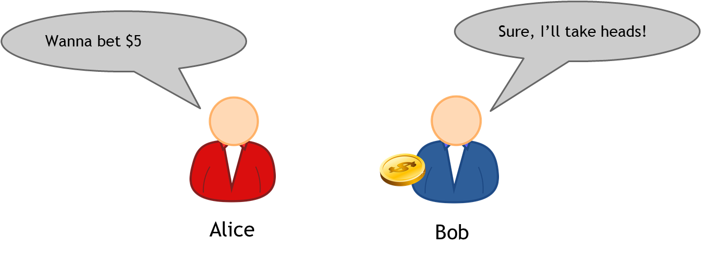
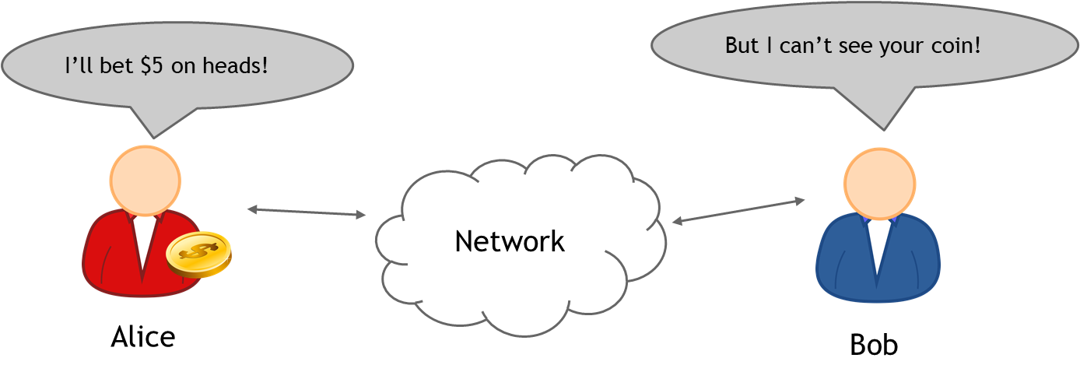
Coin flipping
fair outcomes
trust factor
on a network?
Alice, Bob, and Carol
(x+ y + z)%3 ?
2
Notes:
-normal lottery
-lottery on a network – remotely?
-Alice, Bob, and Carol pick a number between 1 and 3
-easy to manipulate by choosing the last number

Slide 4



Coin flipping online
hash commitments
can’t find an x’≠x later such that H(x’) = H(x)
H(x) reveals no information* about x
Round 1
Round 2
Alice
Choose random x
Publish H(x)
Publish x
Hash function guarantees nobody can win with probability more than 1/3
w= H(x⊕y⊕z) % 3
switch (w){
case 0:
winner = Alice;
case 1:
winner = Bob;
case 2:
winner = Carol;
}
Choose random y
Bob
Publish H(y)
Publish y
Carol
Choose random z
Publish H(z)
Publish z
3
Notes:
*assuming that space of x is big!

Slide 5
issues
Round 1
Round 2
Sorry! I, uhh, forgot z
Not cool Carol ☹
Alice
Choose random x
Publish H(x)
Publish x
w= H(x⊕y⊕z) % 3
switch (w){
case 0:
winner = Alice;
case 1:
winner = Bob;
case 2:
winner = Charlie;
}
I’m about to lose...
Sorry! I, uhh, forgot z
Choose random y
Bob
Publish H(y)
Publish y
Carol
Choose random z
Ø
Publish H(z)
fairness!
Bitcoin
4

Slide 6
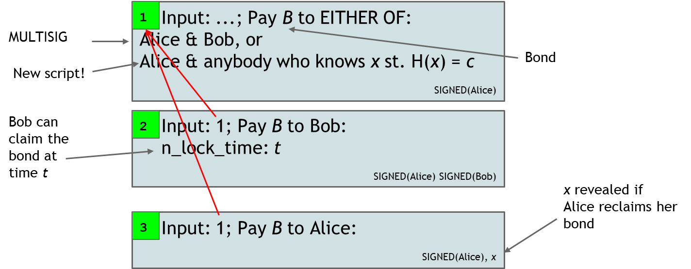
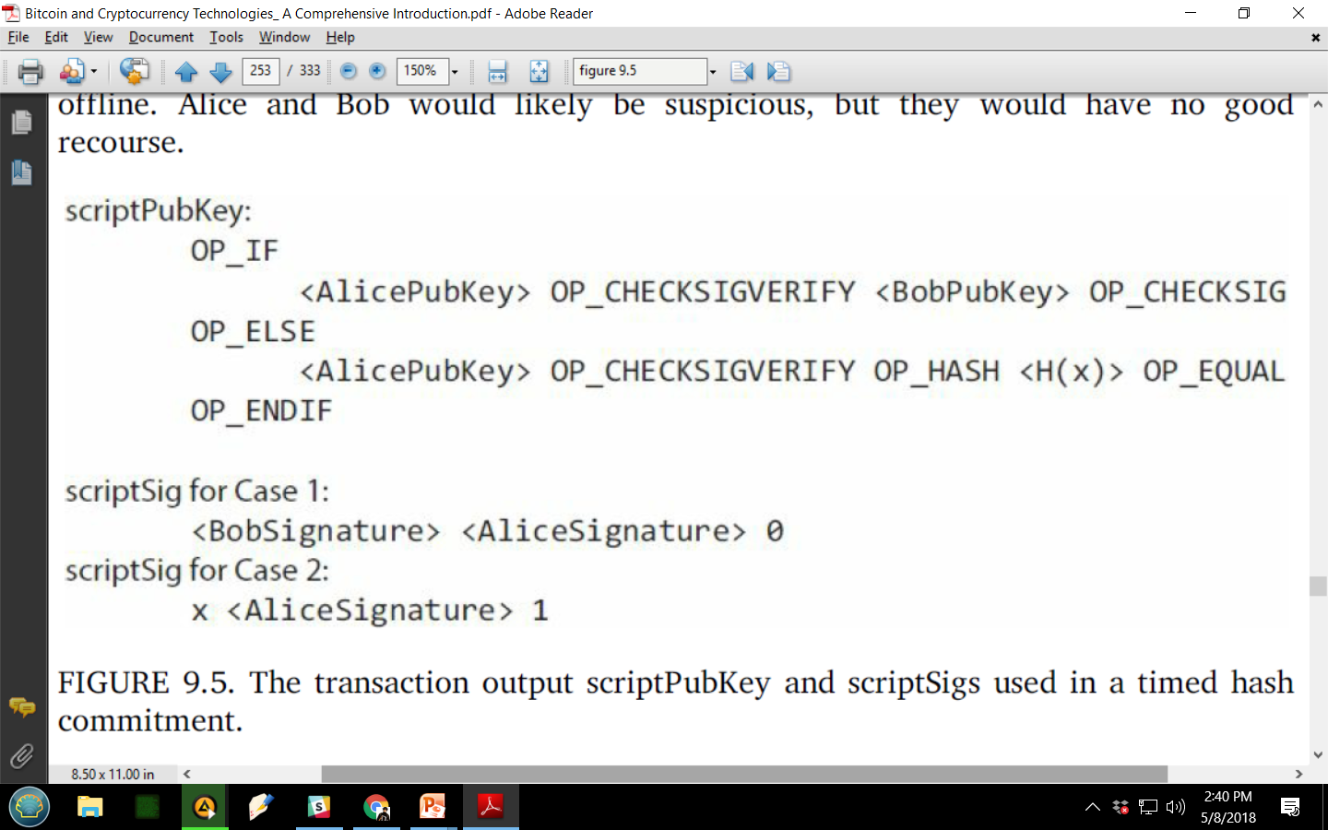
Timed hash commitments
force x to be revealed by time t!
5
Notes:
-Alice puts up a bond, i.e. a transaction the output of which can be spent in one of two ways:
a signed transaction from both Alice and Bob
A signature from just Alice but only if she reveals x
-Alice and Bob ALSO sign a transaction where Bob gets all the money (i.e. method 1) but only after LockTime
-why would Alice agree to this!
-hash commitment becomes a timed commitment! Big step!
-nxn commitments needed because every party has to prepare bonds for every other party

Slide 7
Lottery!
Round 1
Round 2
Choose random x
Timed commitment to H(x)
Alice
Publish x
w= H(x⊕y⊕z) % 3
switch (w){
case 0:
winner = Alice;
case 1:
winner = Bob;
case 2:
winner = Carol;
}
I’m about to lose...
Choose random y
Bob
Timed commitment to H(y)
Publish y
But I’ll lose my bond if I don’t publish ☹
Choose random z
Timed commitment to H(z)
Carol
advantage: can be implemented today!
disadvantage:
O(n²) complexity
bonds higher than amount bet?
6

Slide 8
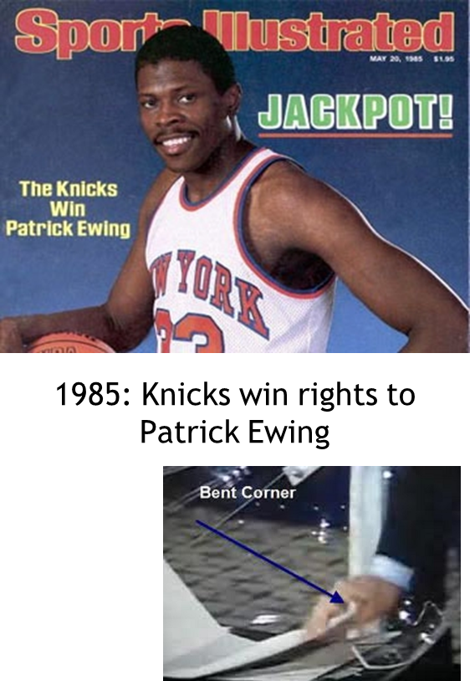
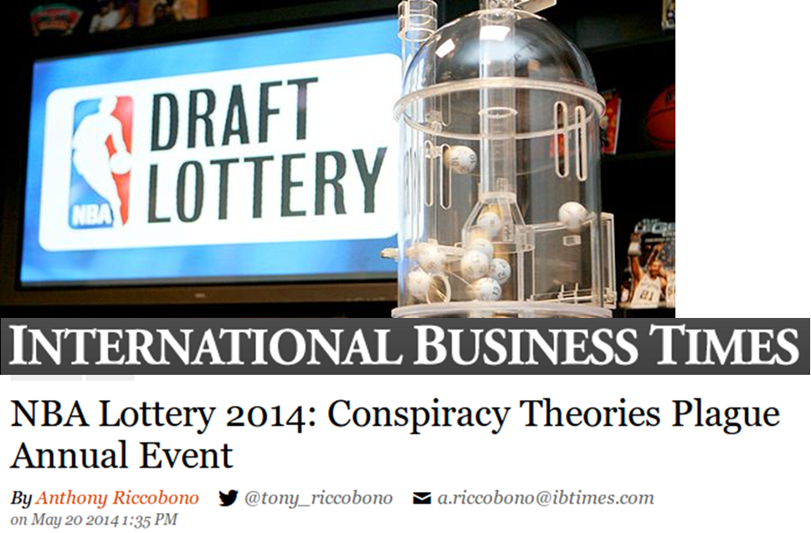
Public randomness
generate trustworthy random values?
7

Slide 9
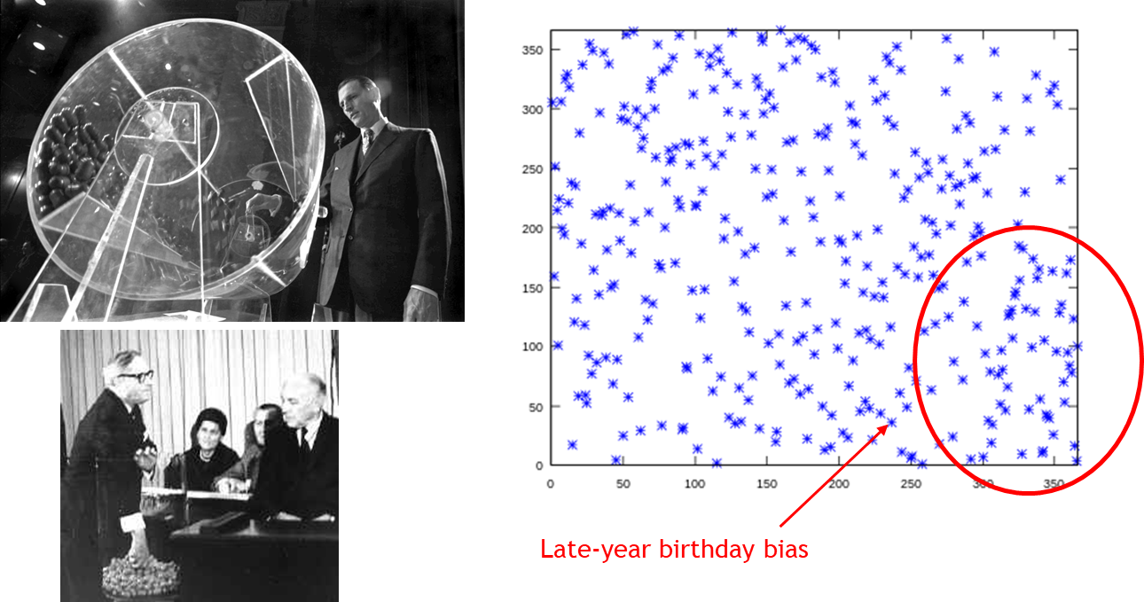
conscription
true randomness
public perception
8
Notes:
-Vietnam war, 1969
-Congressional representatives, dumped small plastic capsule labeled with each day of the year into a large plastic drum, took turns to reach in and pull numbers out
-men given priority number on basis of their birthdays
-priority number determined order in which they would be drafted
-anomaly found within a week
-days late in the year had low draft numbers
-statistically significant
-look at tapes - probably because drum was rotated exactly even number of times and capsules on top remained on top
-insufficient mixing!

Slide 10
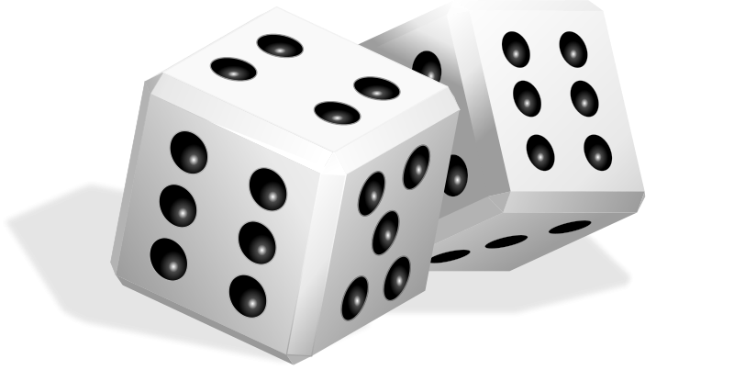

Cryptographic beacons
flipping coins, rolling dice, etc.
sleight of hand
a cryptographic solution?
idea: a service to regularly publish random data
uniform randomness
no party can predict in advance
all parties see the same values
01010001 01101011 10101000 11110000 10010100
Applications: lotteries, auditing, zero-knowledge proofs, cut-and-choose, ...
9
Notes:
-flipping coins and rolling dice are popular because they are cheap and easy to understand but don’t scale because they are difficult to audit

Slide 11
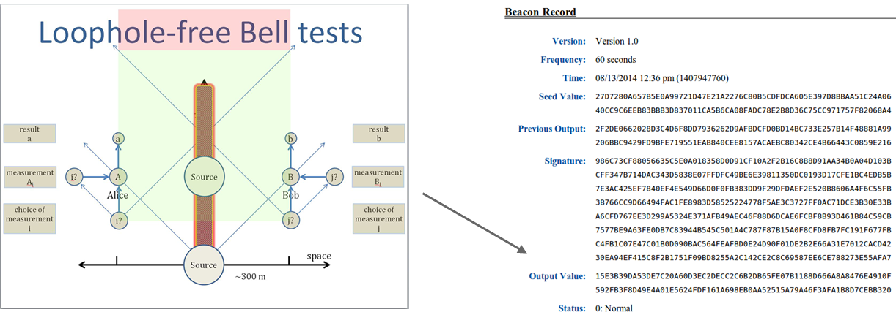
NIST beacon
since 2011
entangled photons (quantum mech. randomness)
new digitally signed random data every 60 seconds
web feed
10
Notes:
-what is the fundamental problem here?
TRUST
-actual lab?
-all numbers are random?
-published on time?
-web site isn’t hacked?
Etc.

Slide 12
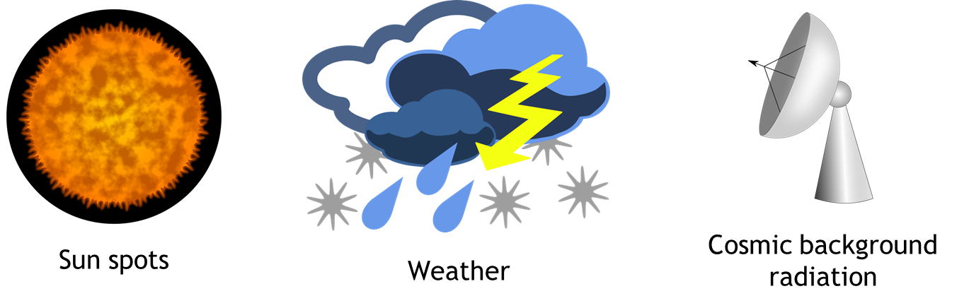
Natural phenomena
pros: publicly observable
truly random
cons: expertise? trusted observers
publicly observable?
slow
digitization? calibration?
11
Notes:
-some phenomena, e.g. weather can be predicted, therefore use least significant digits
-truly random
-too far fetched to believe someone would fly a spacecraft in the sky to tamper with radiation levels

Slide 13
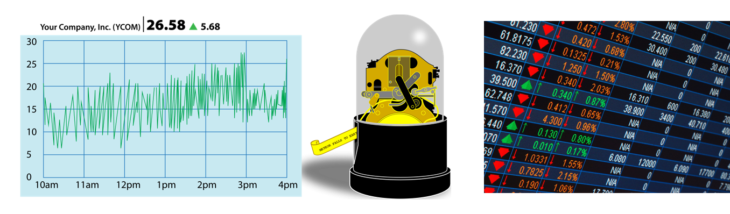
Stock market beacon
pros: reported as digital values
difficult to manipulate
cons: reliance on trusted party
insider manipulation
12
Notes:
-difficult to manipulate/predict – if you can predict to within a penny what a stock value will be, you can become very very rich!
-trusted party in this case is the stock market
-they can insert their own orders in the book to manipulate prices – not easy but not impossible

Slide 14
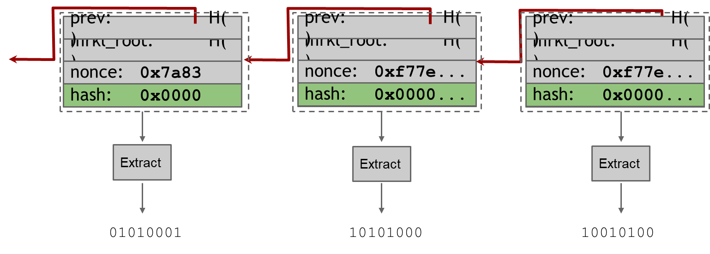
Bitcoin as a beacon
miners find random nonce
If you could predict the next nonce with a greater than 1/d probability, you’d have a mining shortcut
in 2015 - d>2⁶⁶
13
Notes:
-first several bits of any block will be zero
-other bits can be used to generate randomness

Slide 15
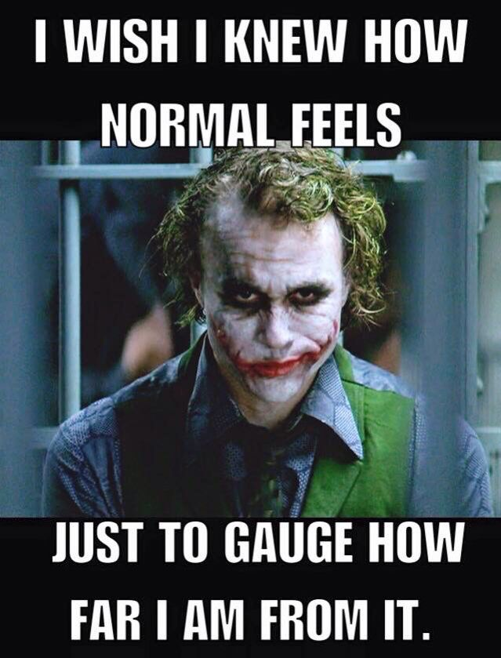
Cost of manipulation
selective discard attack
attacker might mine a block but discard it - or bribe other miners to do so
Bernoulli trials: forcing a beacon outcome requires discarding blocks
discarding a block “costs” 25 BTC!
single coin flip: secure if wager is < 25 BTC
assumption: rational actors
14
Notes:
-coin flip/lottery is feasible if cost of manipulation is greater than cost of bet

Slide 16
Scripting support
randomness in Bitcoin scripts?
randomness using Bitcoin
special new opcode
random decisions within Bitcoin
replace complicated lottery protocol
script reads beacon value
assigns output to one of n addresses
manipulation?
delay transaction until later block
opcode modification – block height specification
15
Notes:
-currently there is no randomness in Bitcoin scripts because its easier for everyone to verify things that way
-special new opcode which could make a random decision based on beacon output of previous block
-entire lottery could be replaced with script
-no multi-round protocols, no security deposits, no timed hash commitments
-miners can manipulate lottery by delaying transaction until later block if it suits them
-does not require them to miss out on block rewards as they would have earlier
-protection – allow opcode to specify particular height from which to read beacon

Slide 17
Prediction markets
idea: create a mechanism to assert facts
elections
lotteries
outcomes of sports games
bets on future events
forwards, futures, options
prediction markets!
idea: trade shares in a potential future event
shares worth X if the event happens, 0 if not
current price / x = estimated probability
16

Slide 18
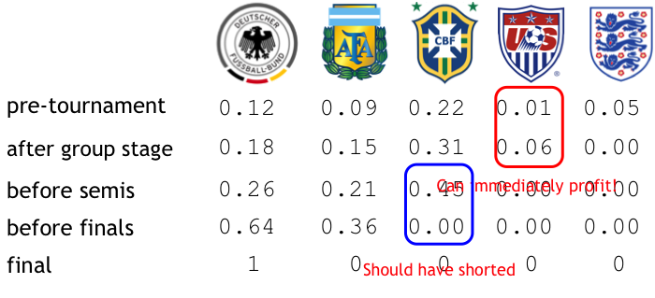
World cup 2014
17
Notes:
-each share for the team that wins is ultimately $1
-Germany starts trading at 12c – which means market believes Germany has a 12% chance of winning
-England was initially trading at 5c – but goes to 0 after group stage because it was knocked out
-US team was initially at 1c – no one thought they had a chance – but after good performance at group stage, shares shot up to 6c – you could make profit by selling shares right then
-US and England have been knocked out at semis – shares have gone to 0
-all other prices have gone up – total add up to 1
-Brazil was supposed to win in semis but got knocked out – shares went straight to 0
-great opportunity to ‘short’ the market
-finally only German shares have any value – because they won
-traditional sports betting (and general investment) – you buy German shares at beginning and just hold on to it
-prediction markets – many other ways to play and profit – move money around all the time, short this, short that

Slide 19
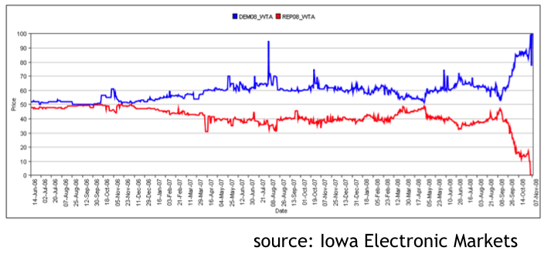
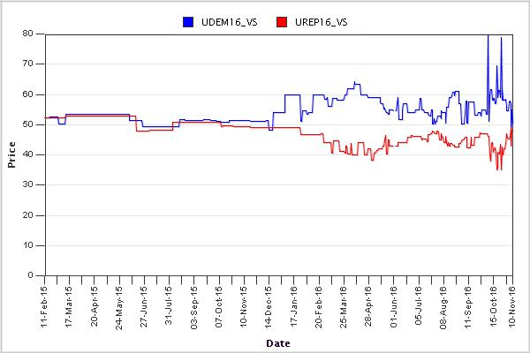
US presidential elections
18
Notes:
-in 2008, day before the election, Obama had a 90% chance of winning
-in 2016, markets were still confused (Trump vs. Hillary)

Slide 20
Prediction markets
economists love prediction markets
valuable social tool
information about the future
important information is often dispersed
the human factor
informed opinion
a tax on nonsense
often beat polls and expert opinions
significant regulatory problems
19
Notes:
-the human factor – people will be interested in profiting from information predicting future

Slide 21
Prediction markets
decentralization
payment and enforcement
arbitration
order book
simple solution
Bitcoin with trusted arbiters
proper solution
altcoin with built-in support
Futurecoin!
20
Notes:
-we need a way to accept and disburse money according to outcomes
-we need decentralized arbitration
-we need a decentralized way for people to find counterparties to trade shares with – i.e. the order book

Slide 22
futurecoin
transaction types:
CreateMarket (event_id, arbitrator_key, num_outcomes)
BuyPortfolio(event_id)
TradeShares(…)
SellPortfolio(event_id)
CloseMarket(event_id, outcome_id)
example
World Cup, 32 teams
BuyPortfolio: 1 coin = 32 shares, 1 for each team
SellPortfolio: sell a share to get futurecoin
21
Notes:
-CreateMarket allows user to create a prediction market
-arbitrator (with public key) is authorized to declare outcomes for the event
-event_id is a string that identifies various transactions for the same market
-BuyPortfolio – purchase one share in every outcome for 1 futurecoin
-TradeShares transfers shares in exchange for futurecoins
-SellPortfolio – redeem one share in every outcome for 1 futurecoin
-Futurecoin itself does not care about what real-world event event_id refers to, nor what outcomes are, and there is no way to specify these in the system
-1 coin gives 32 shares – this is fair, because ultimately only one team will actually win!
-Buy-and-SellPortfolio let you enter and exit the market – similar to casino – you buy chips!
-once you have shares, you need people to transact them with

Slide 23
Arbitration models
trusted arbiters
allow anybody to define & open a market
risk of incorrect arbitration, absconding
users vote (multiple arbiters)
requires incentives, bonds, reputation
keynesian beauty contest?
legitimate disputes
miners vote
may be disinterested or not know
22
Notes:
-trusted arbiter used in CreateMarket command
-often creator can be arbiter too – anyone can then launch a market
-arbiter signs CloseMarket transaction with outcome_id – that determines who won
-arbiter can choose outcome depending on their own bets
-reputation vs. profits – in some cases it might be worth ruining one’s reputation for profit
-in majority voting conditions, people might not arbitrate based on ground truth but on what they expect the majority to vote -Keynes believed that similar behavior was at work within the stock market. This would have people pricing shares not based on what they think their fundamental value is, but rather on what they think everyone else thinks their value is, or what everybody else would predict the average assessment of value to be.
legitimate disputes

Slide 24
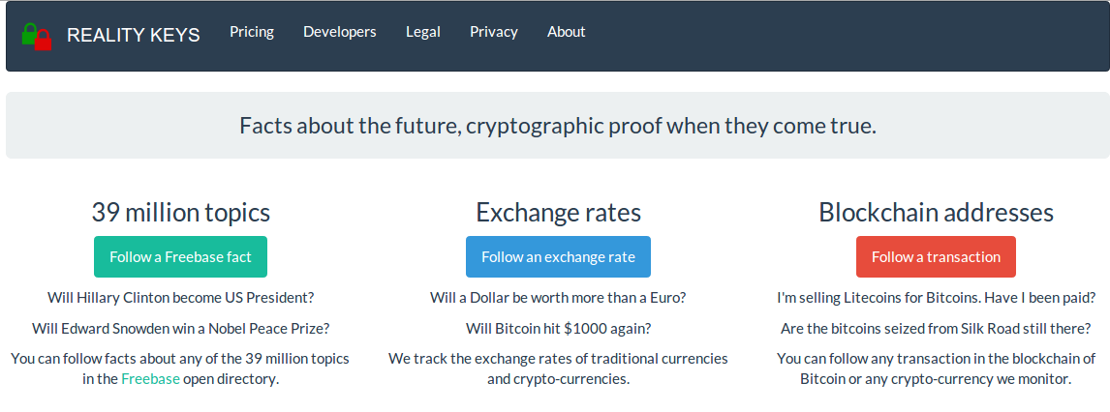
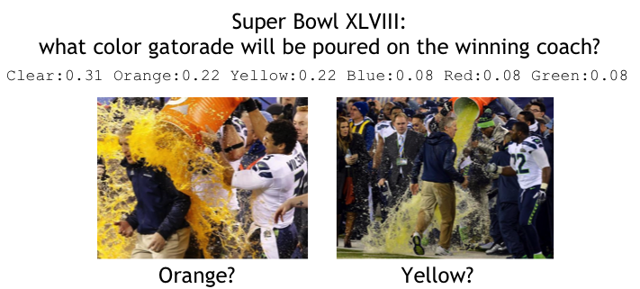
Arbitration models
data feeds
scripts to use data feeds
23
Notes:
-By limiting its role to providing data and making it usable on the block chain, Reality Keys empowers users to create their own digital contracts and transact directly with each other.
It is all, of course, anonymous. Reality Keys provides only the keys, and has no interest in or knowledge of the nature of the contract or the amounts of bitcoin at stake.
-RealityKeys creastes two keys pairs for every event of interest, Yes and No. Public keys of both pairs are published. Arbiter publishes one of the private keys when the event is settled. Alice and Bob can therefore place bets. If Alice wins the Yes vote, the transaction is claimed using a signature from Alice and the Yes key, otherwise a signature from Bob and the from the No key.
-Similar companies have since risen, like Predictious, which takes bitcoin bets on anything "from presidential elections to the Oscars, to the sales of the iPad." The catch is that you need to deposit your money with a third party, Predictious itself.
-reality can also be complicated. Arbitration is partly a social problem and a technological solution can only go so far
-data feeds – example, a script that daily loads the price of copper onto the stack and make decisions based on that value!
-data feeds could enable far more than prediction markets – proper financial instruments and markets
-you could hedge risks

Slide 25
Order books
no single market price
bids and asks
match buyers and sellers
frontrunning is criminal activity
idea: Submit orders to miners, let them match any possible trade
spread is retained as a transaction fee
may be less efficient
higher fees
slower trades to avoid higher fees
24
Notes:
-ask is the lowest price one is willing to sell the share for
-bid is the highest price one is willing to pay
-in a centralized setup, the exchange generally collects all orders and matches buyers and sellers
-involving miners defeats frontrunning but has problems
-traders might not want to pay miner feeds – and make much more conservative orders
-market becomes less efficient
-this problem remains
-a dishonest exchange may buy from the best bet and then sell their shares at a higher price, and pocket the difference!
-requires regulation, monitoring, auditing
-Bitcoin only takes us so far!

Slide 26
Homework
Chap 9: Bitcoin as a platform Bitcoin and Cryptocurrency Technologies: A Comprehensive Introduction
RealityKeys (link)
16

Slide 27
Further reading
Hillary vs. Trump on prediction markets (link)
Financial WMDs and Hunger Games (link)
16

